Slide 1

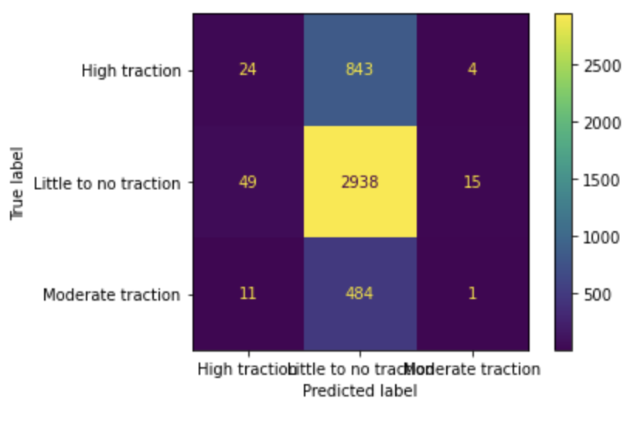
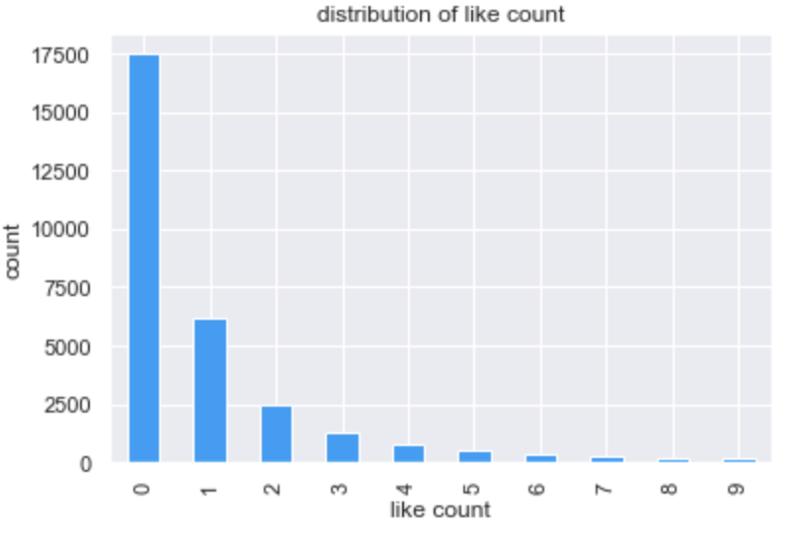
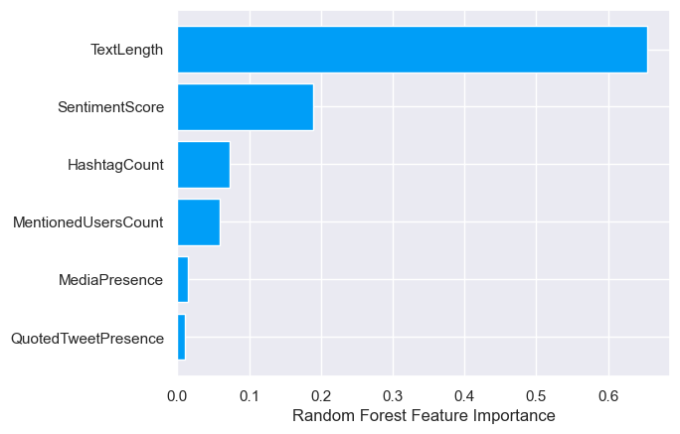
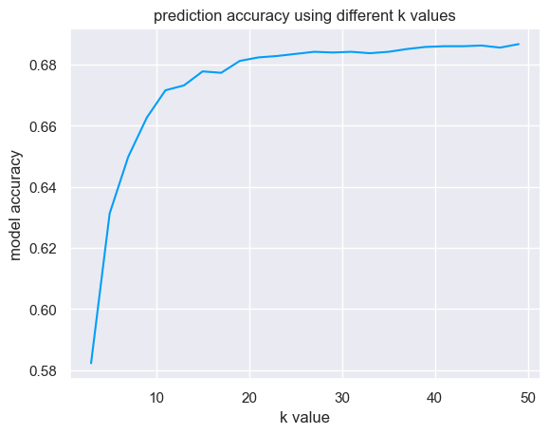
Analyzing the Traction of ChatGPT Content on Twitter
Priyanka Adhikari, Ruchira Banerjee, Nidhi Bendre
DS 3000 - December 2023
Abstract
Methodology
Results and Evaluation
Artificial Intelligence (AI) has skyrocketed in popularity recently, with models like ChatGPT (developed by OpenAI) bringing AI-driven capabilities to the everyday user. With this new technology making strides in the lives of millions, we decided to assess users’ sentiment as reflected in social media posts, specifically through posts on Twitter, and determine whether or not "ChatGPT"-related Twitter posts garner more or less engagement based on sentiment. These results will prove helpful to members of the AI community who are looking to appeal to everyday consumers of their products. With the use of Random Forest Classification models, we found that a post’s sentiment tends to play a significant role in the post’s resulting level of engagement.
Data Preparation
We first removed observations that did not contain text in English. We then dropped all observations with null values and removed all invalid data (such as negative like count). Additionally, due to the highly skewed nature of our data (shown below), we removed observations with LikeCount = 0.
After calculating the sentiment score for all data observations using the Afinn Python library, we appended the score as a new column in the dataframe. We then dropped all irrelevant columns.
Prior to model training, columns like Media and QuotedTweet were encoded into new columns (MediaPresence and QuotedTweetPresence) indicating their presence with 1’s or 0’s. We also created new columns MentionedUsersCount and HashtagCount, where the columns quantify the number of mentioned users and the number of hashtags in each tweet (respectively) from the original columns. SentimentScore captures sentiment for each tweet's Text. TextLength, records the character count of the original Text column. Lastly, traction was created to categorize LikeCount by dividing the like count into the following categories: “Little to No Traction,” “Moderate Traction,” and “High Traction.” Input features are: SentimentScore, MediaPresence, QuotedTweetPresence, MentionedUsersCount, HashtagCount, and TextLength, and traction is the target variable.
Model Selection
As the target variable (traction) is categorical, we decided to compare 3 classification algorithms: K-NN classification, Random Forest Classification, and Support Vector Machine (SVM). We felt that these models would best capture the complex relationships within the dataset and effectively provide insights into the importance of different features to help understand how the content of a ChatGPT tweet relates to its traction.
To train the model, we partitioned the dataset into 70% training and 30% testing, ensuring reproducibility by setting random_state to 7 and stratifying our samples. To hyper-parameter tune, for K-NN we obtained the best n_neighbors value by looping through various values and finding the result with the highest resulting value from the score() function (shown on the right). For the Random Forest classifier and SVM model we used GridSearchCV to tune n_estimators and C & gamma respectively.
We compared the accuracy and recall scores for all three models and the Random Forest Classifier had the best accuracy and recall scores followed by the K-NN Classifier and the Support Vector Machine. Therefore, we selected this model to determine our results.
Among the three distinct machine learning methods, Random Forest Classification ultimately proved to be the most effective model for this dataset. Across all three models, the accuracy score was around 0.68-0.69 indicating that the models correctly predicted the outcome approximately 68-69% of the time. However, the classification report indicated that both the K-NN classification and SVM models had a recall of around 0 for high and moderate traction levels, and a recall of 1 for little to no traction. This highlights an important setback in our dataset, as the right skewness of the data with an overwhelming number of tweets with 1-2 likes resulted in biased models that could only correctly identify positive instances for little to no traction. In comparison, the Random Forest Classification model had scores of 0.03, 0.98, and 0.00 for high, little to no, and moderate traction, respectively. For this reason, we chose Random Forest Classification as the best overall model for this dataset, as even with the skewness of the training set, the model was more effective in classifying all traction levels.
As seen in the Feature Importance graph below, TextLength, SentimentScore, and HashtagCount proved to be the three most important variables when determining the traction level of a tweet.
We plotted a confusion matrix (in the upper right) to depict the ratio of predicted labels to true labels for our Random Forest Classifier. We can see that the observations with Little to No Traction were labeled correctly most frequently, and observations with Moderate Traction were labeled correctly least frequently.
High Traction
Little to No Traction
Moderate Traction
Prediction Label
Introduction
Impacts
As the landscape of AI constantly evolves, monitoring public discourse on platforms like Twitter becomes imperative for enhancing product development and addressing user concerns effectively. One popular AI model is ChatGPT, deployed in late 2022 by OpenAI.
The primary goal of our project is to extract meaningful insights from Twitter data involving ChatGPT, elucidating changing public opinions and identifying tweet characteristics that garner significant engagement. Such public discourse on ChatGPT may provide OpenAI and the AI community with valuable insights for improving their future products and addressing related concerns.
We aim to delve into the sentiments expressed on Twitter regarding "ChatGPT" by conducting a comprehensive sentiment analysis of Twitter data on "ChatGPT"-related posts during a specified time frame. We will then utilize each posts’ sentiment score and accompanying characteristics to predict (through classification) the level of traction (categorized by number of likes) that the post will garner. As previously mentioned, this will provide insights into public opinion on ChatGPT, and will allow us to identify whether or not "ChatGPT"-related Twitter posts garner more or less traction based on sentiment.
The proposed solution aiming to analyze sentiment and traction of ChatGPT content on Twitter holds several potential impacts. Insights derived from this analysis will directly benefit OpenAI and the broader AI community. Understanding public perceptions and evolving opinions about ChatGPT will not only aid OpenAI to refine their current product but it will also shape their future developments.. This could involve addressing concerns, improving user experiences, and guiding future iterations of ChatGPT. By identifying trends, preferences, and sentiment shifts, OpenAI can ensure that forthcoming versions of ChatGPT align more seamlessly with user needs and expectations. This will essentially increase their engagement and impact and users will directly benefit as their experience will improve. Lastly, public sentiment on artificial intelligence adds to the ethics discourse surrounding new technology and can potentially influence policymakers to in shaping guidelines governing AI technology use.
Conclusion
The goal of this project was to classify Twitter posts’ level of traction based on their sentiment and determine the relationship between sentiment and a post’s level of traction (number of likes). After developing the Random Forest Classifier with an accuracy of about 65%, we can conclude that tweets about ChatGPT are significantly affected by their sentiment. However, the dataset did have its limitations such as the extreme right skewness when it came to the distribution of like counts. Additionally, the data only covered tweets over the span of 2 days, so the conclusions drawn from this analysis cannot be generalized. A potential improvement to the model could be scraping data directly from Twitter which can provide a more evenly distributed dataset. As a future line of work, the same analysis can be done for other AI models (such as Google’s Bard) and the results can be compared.
Related Work
Twitter's microblogging format offers a valuable avenue for gauging public sentiment on diverse topics through sentiment analysis. During the Covid-19 pandemic, researchers utilized Twitter data to track evolving public sentiments, revealing shifts in behaviors, emotions, and opinions. Previous studies segmented the pandemic's timeline, employing methods like topic modeling and feature extraction to delve into people's changing sentiments. These studies retrieved tweets using pandemic-related hashtags and analyzed their accompanying frequencies and sentiments.
Data Acquisition
Bibliography
The dataset was taken from the following using Kaggle: ChatGPT Twitter Dataset | Kaggle and contains tweets with the term “ChatGPT” from January 22nd - 24th, 2023.
Qi, Yuxing, and Zahratu Shabrina. “Sentiment analysis using Twitter data: A Comparative Application of lexicon- and machine-learning-based approach.” Social Network Analysis and Mining, vol. 13, no. 1, 2023, https://doi.org/10.1007/s13278-023-01030-x.
Tariq, Muhammad. “CHATGPT Twitter Dataset.” Kaggle, 24 Jan. 2023, www.kaggle.com/datasets/tariqsays/chatgpt-twitter-dataset.
Notes:
For our project, we decided to analyze Twitter data revolving around the topic of ChatGPT and how its sentiment (public opinions categorized as positive, negative, or neutral) along with other Tweet characteristics such as length, hashtag count, media presence, etc. affect how many likes the Tweet receives. After creating a feature importance graph, we found that text length and the sentiment of the Tweet significantly influenced the traction the Tweet received. So the goal of our project was realized as sentiment plays a role in tweet popularity. However the data we used had its limitations due to the distribution of like count across all Tweets was extremely right skewed (many Tweets had 0 to 2 likes). This made the predictions from our model less reliable as the predictions were biased towards lower traction levels, leaving the model less accurate in terms of predicting whether a Tweet would receive moderate or high traction.

